Slide 1
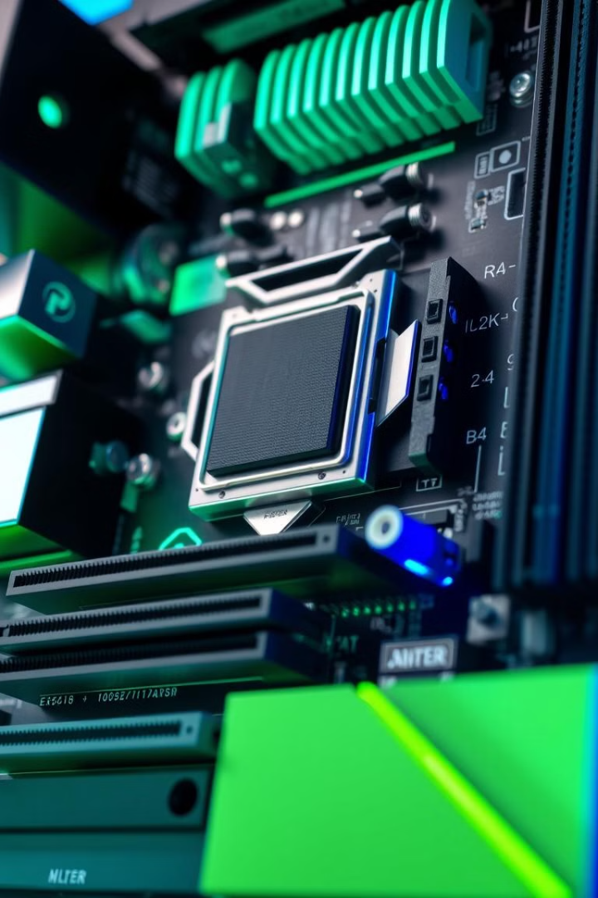
Functional Units in Computer Organization
Computer organization is a fascinating field that delves into the inner workings of computers. It focuses on the functional units that make up a computer system and how they interact to execute instructions and process data.

Slide 2
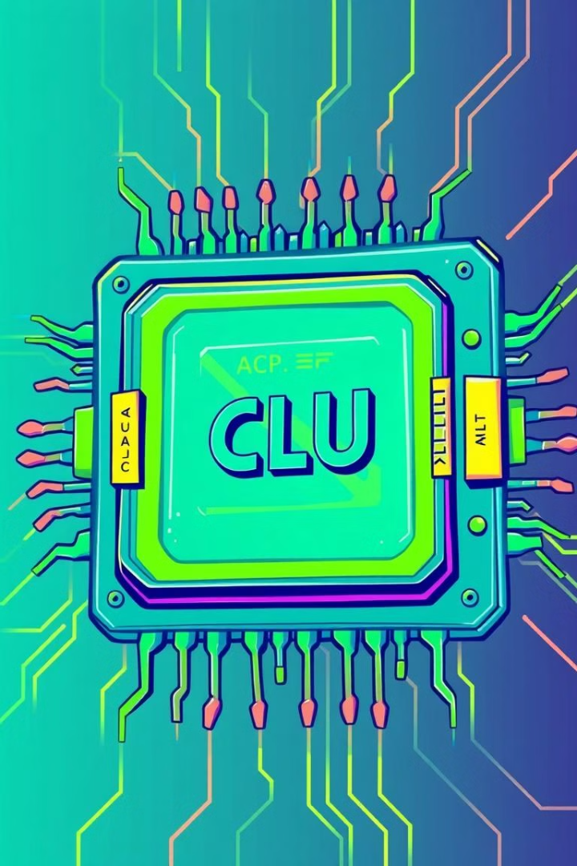
Central Processing Unit (CPU)
The CPU, often referred to as the brain of the computer, is responsible for executing instructions and performing calculations. It fetches instructions from memory, decodes them, and executes them using its various functional units.
Instruction Fetch
Data Fetch
The CPU fetches instructions from memory and decodes them.
The CPU fetches data from memory to be processed.
Instruction Execution
Data Storage
The CPU executes instructions using its ALU and control unit.
The CPU stores results in registers for future use.

Slide 3
Memory Unit
The memory unit acts as the short-term storage for the CPU, holding data and instructions that are actively being used. It enables the CPU to access information quickly and efficiently.
RAM (Random Access Memory)
ROM (Read Only Memory)
Cache Memory
ROM is non-volatile memory, meaning that data is retained even when power is turned off. It is used for storing the basic instructions that the computer needs to start up.
Cache memory is a small, fast memory that stores frequently accessed data. This helps to speed up the performance of the CPU.
RAM is volatile memory, meaning that data is lost when power is turned off. It is used for storing data that the CPU needs to access quickly.

Slide 4
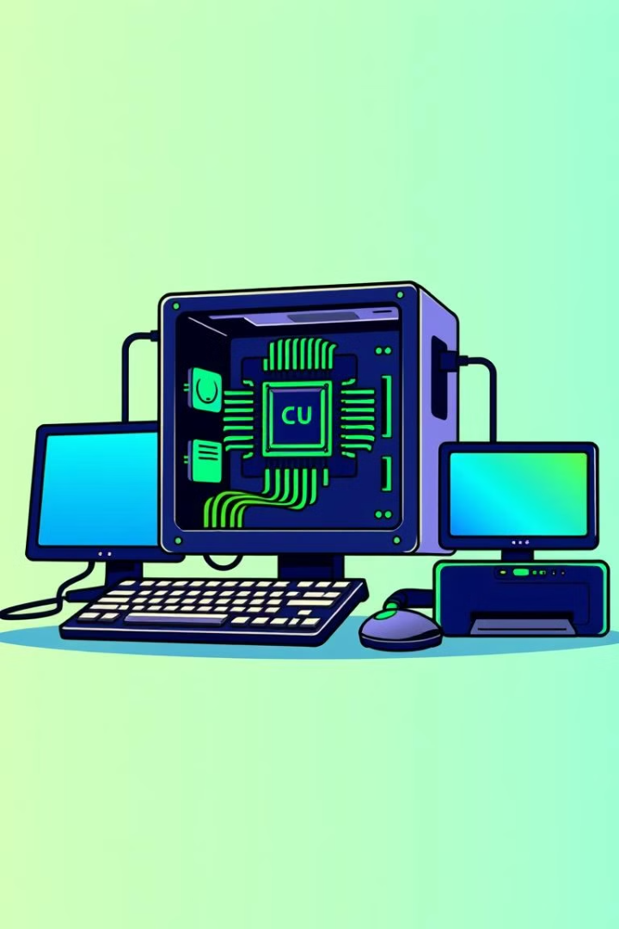
Input/Output (I/O) Unit
The I/O unit acts as the interface between the computer and the outside world. It allows the computer to receive data from input devices and send data to output devices.
1
Input Devices
2
Output Devices
Input devices such as keyboards, mice, and scanners allow users to enter data into the computer.
Output devices such as monitors, printers, and speakers allow the computer to display or output data.
3
I/O Controllers
I/O controllers manage the communication between the CPU and I/O devices.

Slide 5
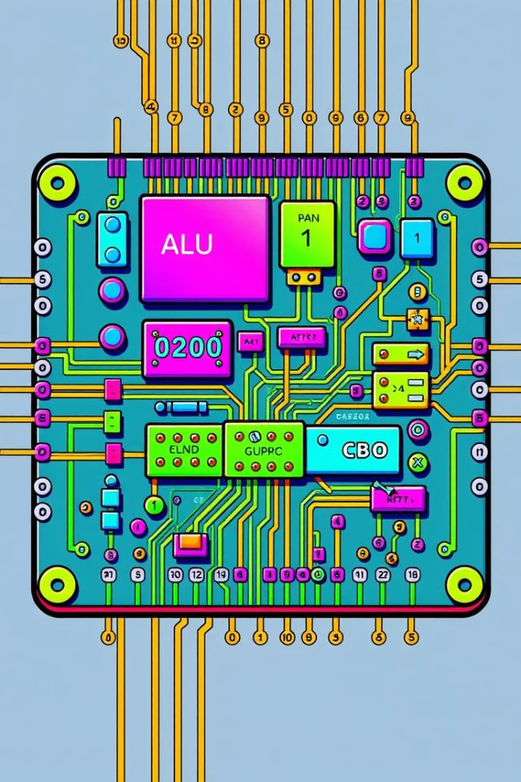



Arithmetic Logic Unit (ALU)
The ALU is the computational heart of the CPU, responsible for performing arithmetic and logical operations on data. It can add, subtract, multiply, divide, and perform bitwise operations.
Data Input
The ALU receives data from registers.
Operation
The ALU performs the specified arithmetic or logical operation.
Data Output
The ALU outputs the result to registers.

Slide 6
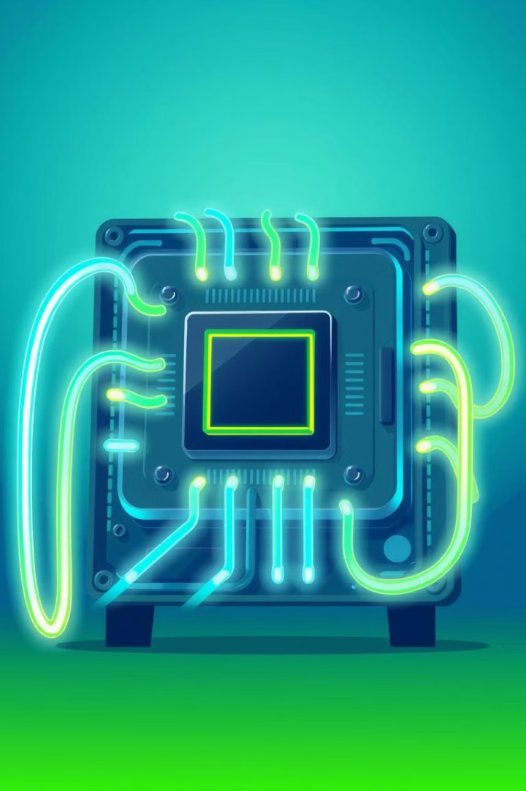
Control Unit (CU)
The CU is responsible for controlling the flow of instructions within the CPU. It fetches instructions from memory, decodes them, and issues control signals to other components.
1
Instruction Fetch
The CU fetches the next instruction from memory.
2
Instruction Decode
The CU decodes the instruction to determine its operation.
3
Execute Instruction
The CU sends control signals to other components to execute the instruction.
4
Update Program Counter
The CU updates the program counter to point to the next instruction.

Slide 7
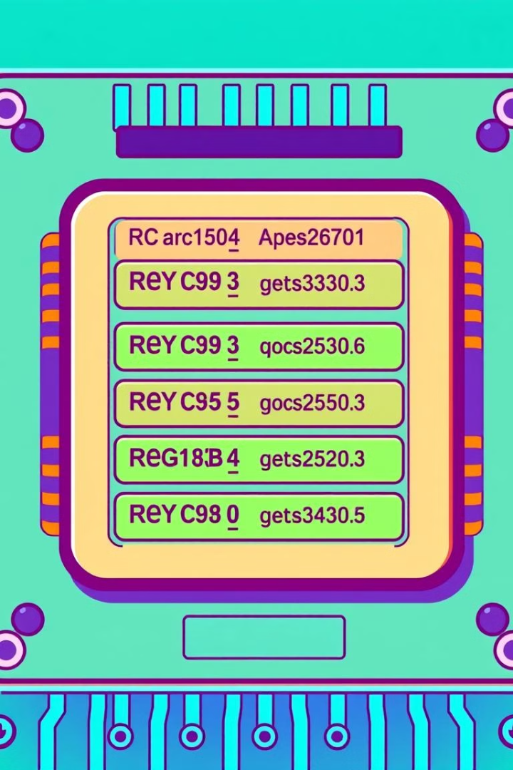
Registers
Registers are small, high-speed storage locations within the CPU. They hold data that is actively being used, providing fast access for the ALU and CU.
General Purpose Registers
Used for holding data and intermediate results during computations.
Special Purpose Registers
Used for specific purposes, such as holding the program counter or status flags.

Slide 8
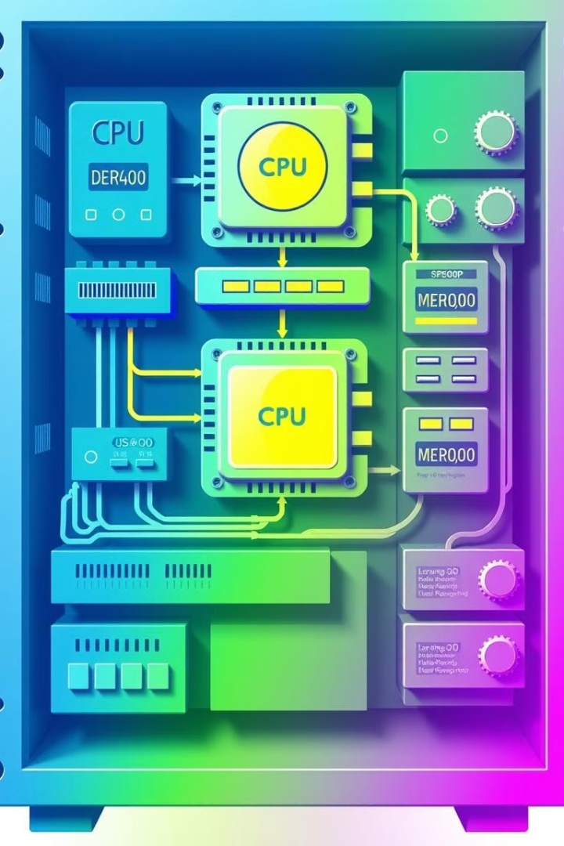



Interconnections and Data Paths
The various functional units of a computer system are interconnected through a network of data paths and buses. These pathways allow for efficient data transfer between different components.
Bus
A set of parallel wires that carry data, addresses, and control signals.
Data Path
A route through which data flows between different components.
Control Signals
Signals that control the operation of different components.

